Slide 2
toolbox
FOR PRESENTATIONS

Slide 3
About the Toolbox for Presentations
You don’t have to delete the slides within this toolbox. To hide them, simply click on the triangle () above this slide’s thumbnail on the left.
Tips Helpful advice on working with this template and building effective presentations
Examples Pre-formatted slides and graphics suggest ways to present various types of content
This toolbox provides a number of resources that make using PowerPoint and this template easier.
Look for the orange icons on the right to find the help you need.
How-tos Simple instructions on how to use key PowerPoint features
Coming soon…
Additional help Post your questions and comments in Yammer > GL Training and Presentations.
Tutorials Video tutorials for how-tos available in Brainshark

Slide 4
Using the colour palette
The colour palettes for fonts, charts, shapes, tables, SmartArt, and WordArt use the SRK theme colours shown on the right. Headings use Dark 2. Shapes and SmartArt use Accent 1 by default.
Suggestions:
Use Dark 2 for headings within text.
Use White, Black, Light 2, and Dark 2 for slide background colours.
Add additional colours if needed.
255
255
255
0
0
0
243
242
229
102
102
102
White
Black
Light 2
Dark 2
243
112
33
75
172
198
128
100
162
155
187
89
192
80
77
255
255
255
Accent 1
Accent 2
Accent 3
Accent 4
Accent 5
Accent 6
0
0
0
243
112
33
Hyperlink
Followed Hyperlink

Slide 5
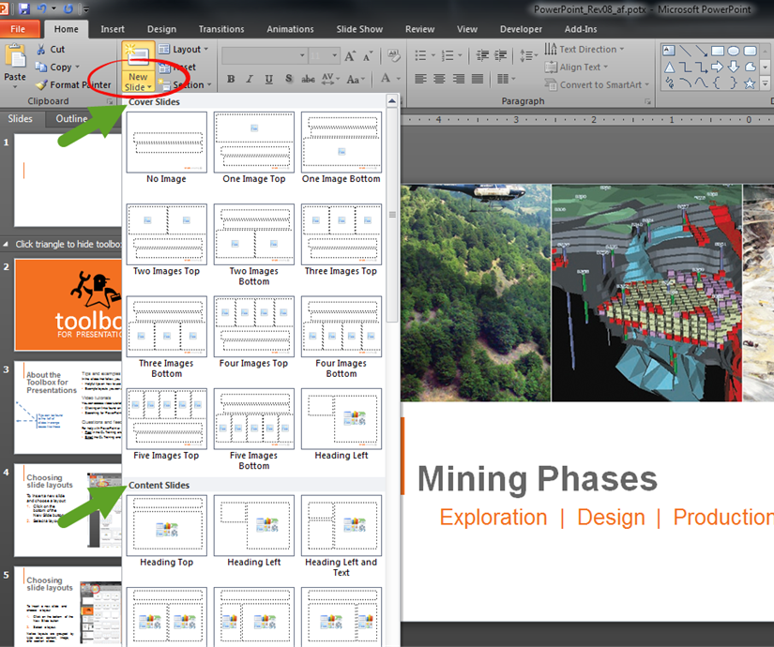
Choosing slide layouts
Example slides are provided in this toolbox. You can copy most of these slides and use them as starting points for your own slides.
To insert a new slide and layout:
Click on the bottom of the New Slide button (red circle).
Choose a slide layout.
Layouts are grouped (green arrows) into cover, content, image, and section slides.

Slide 6
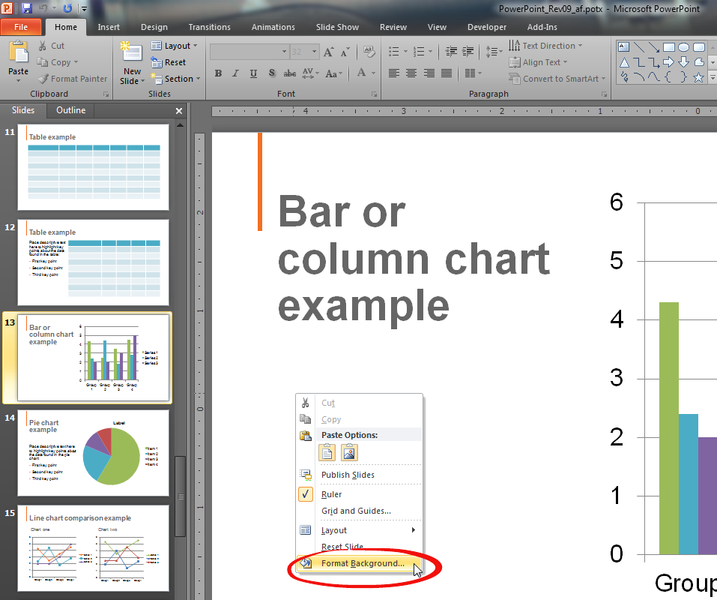
Adding a background colour
Background colours can be used to group content and to provide visual interest (see Using the colour palette for suggestions).
To change a slide’s background color:
Right-click the slide and choose Format Background (red circle).
Choose a fill color and click Close (not Apply to All).

Slide 7
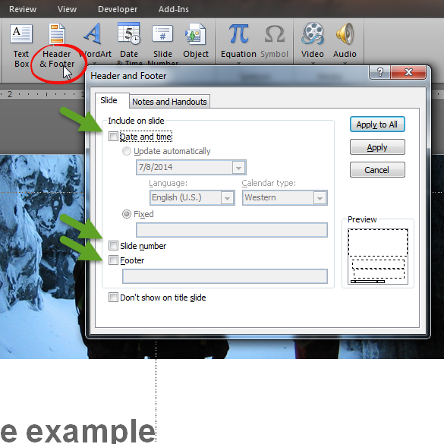
Adding footer information
The footer of each slide contains fields for date and time, slide number, and other information (e.g., a filename).
To add footer information,
On the Insert tab, in the Text group, click Header & Footer (red circle).
Select the Date and time, Slide number, and/or Footer check boxes (green arrows) as desired. Add desired information in the footer field.

Slide 8
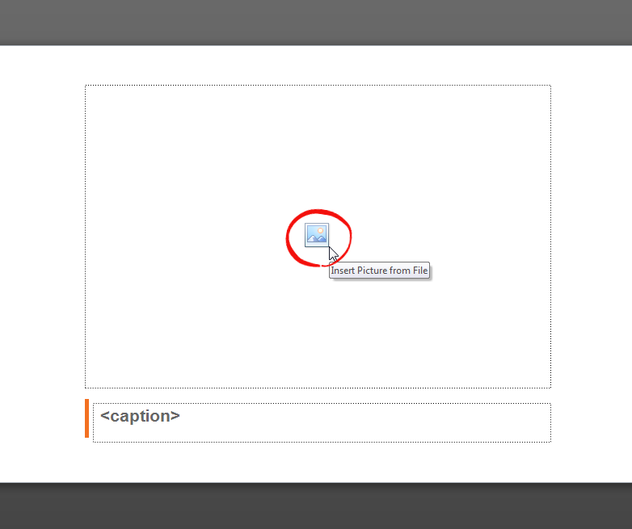
Inserting a picture
Picture placeholders make it easy to place images into your presentation.
To insert an image,
From an image slide, click the picture icon (red circle).
Choose an image and click Insert.
To change an image,
Right-click an image and choose Change Picture.

Slide 9
Example section slide
Example Slide
Section slide: No Image
Section slides provide visual breaks between components.
To change the background color of a section slide, right-click the slide and choose Format Background. Choose a fill color and click Close. Do not click Apply to All.
Section One

Slide 10
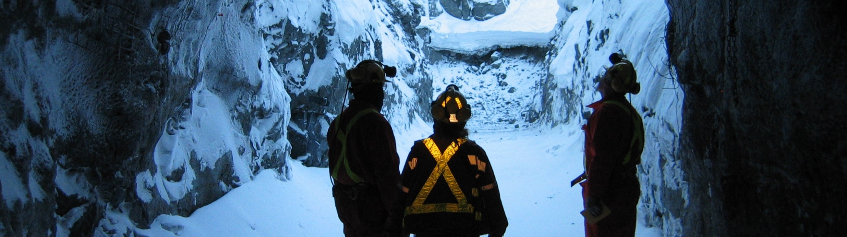
Cover slide example
Example Slide
Cover slide: One Image Top
The default cover slide does not contain images. Other cover slides contain up to five images positioned at the top or bottom of the slide.
For best results, create a new cover slide based on the number of images you want to use (see Choosing slide layouts).
Twelve cover slides are available in this template

Slide 11
Table example
Example Slide
Content slide: Heading Top
This layout is ideal for presenting wider tables and charts. If you want to use this layout, try starting with a new Heading Top slide (see Choosing slide layouts).

Slide 12
Table example
Example Slide
Content slide: Two Content 2
This and the Two Content 3 slide allow you to highlight key points using descriptive text on left or right. If you want to use this layout, try starting with a new Two Content 2 or Two Content 3 slide (see Choosing slide layouts).
Place descriptive text here to highlight key points about the data found in the table:
First key point
Second key point
Third key point

Slide 13
Bar or column chart example
Example Slide
Content slide: Heading Left
This layout places the heading on the left to maximize vertical space for charts, tables, etc.
To add your data to this slide, right-click the graph and choose Change Chart Type and/or Edit Data. Then, copy the slide to your presentation.

Slide 14
Pie chart example
Example Slide
Content slide: Heading and Text Left
This layout places the heading and a text area on the left to maximize vertical space for images.
Place descriptive text here to highlight key points about the data found in the pie chart:
First key point
Second key point
Third key point
To add your data to this slide, right-click the graph and choose Change Chart Type and/or Edit Data. Then, copy the slide to your presentation.

Slide 15
Line chart comparison example
Example Slide
Content slide: Comparison
This layout is useful when comparing two charts, lists, tables, or images.
Chart one
Chart two
To add your data to this slide, right-click the graph and choose Change Chart Type and/or Edit Data as needed. Then, copy the slide to your presentation.

Slide 16

This caption is for the above image and can fill up to two lines with text
Example Slide
Content slide: One Image
If you want to focus on a single image, give this slide layout a try.
To add your own image to this slide, right-click the image and choose Change Picture. Then, copy the slide to your presentation.

Slide 17
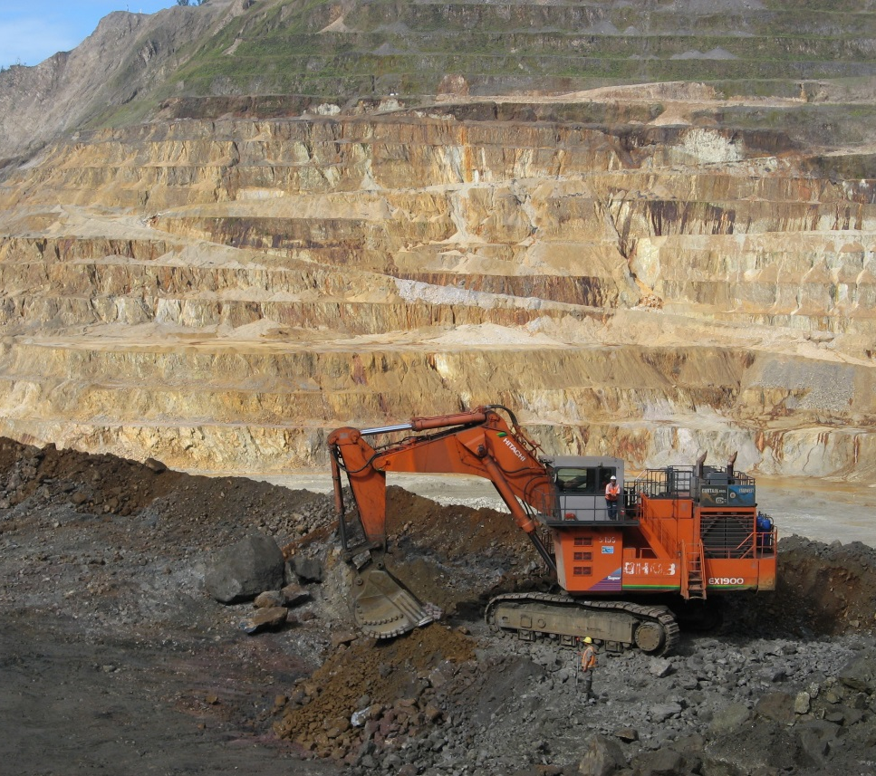

Caption for image one
Example Slide
Content slide: Two Images
This slide layout lets you present or compare two images.
To add your own images to this slide, right-click an image and choose Change Picture. Then, copy the slide to your presentation.
Second image caption

Slide 18
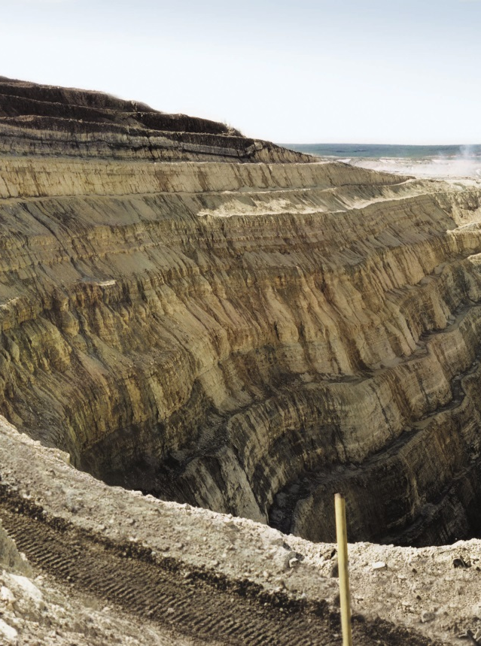
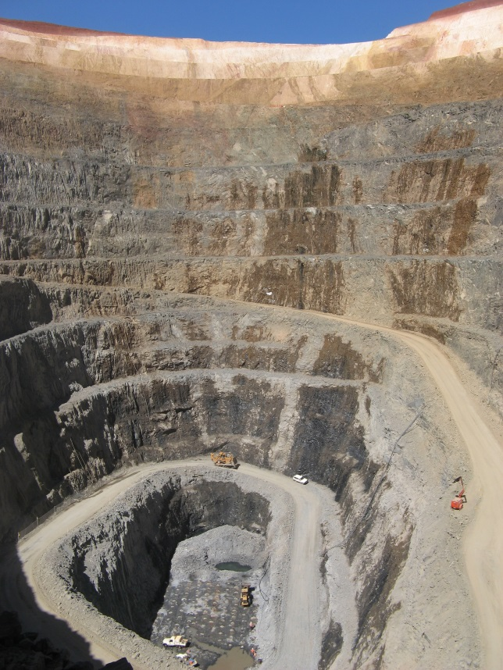
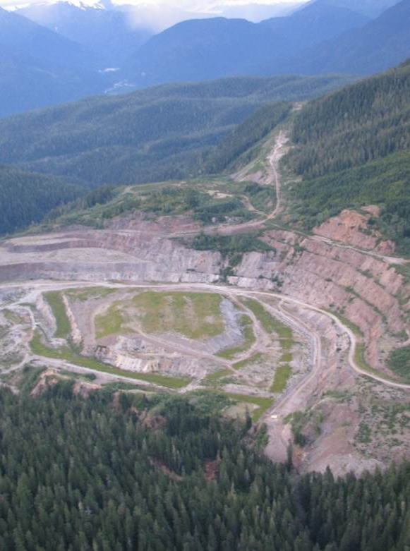
Caption for the first image on this slide
Example Slide
Content slide: Three Images
This slide layout lets you present or compare three images.
To add your own images to this slide, right-click an image and choose Change Picture. Then, copy the slide to your presentation.
Image two caption
Caption for third slide

Slide 19
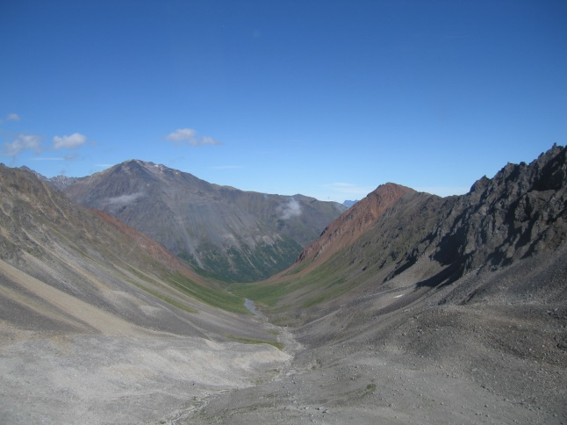



Example Slide
Image caption number one
(a)
Caption two
(b)
Content slide: Four Images
This layout lets you present or compare four images.
To add your own images to this slide, right-click an image and choose Change Picture. Then, copy the slide to your presentation.
(c)
Third caption
(d)
Fourth image caption

